Slide 1


How to milkify the music Kow?
OR
How suitable are spotify’s audio features for creating curated playlists using K-means?
Research by
Prachi, Olga, Elyesa

Slide 2
MAIN QUESTIONS
Are Spotify’s audio features able to identify “similar songs”, as defined by humanly detectable criteria?
Is K-Means a good method to create playlists?

Slide 3
DATA
Data of 5000 songs from spotify
8 Features for analysis:
Danceability: describes how suitable a track is for dancing
Energy: represents a perceptual measure of intensity and activity
Loudness: overall loudness of a track in decibels (dB)
Speechiness: detects the presence of spoken words in a track
Acousticness: confidence measure whether the track is acoustic
Instrumentalness: predicts whether a track contains no vowels
Valence: describes the musical positiveness conveyed in a track
Tempo: overall estimated tempo of a track in beats per minute (BPM)

Slide 4
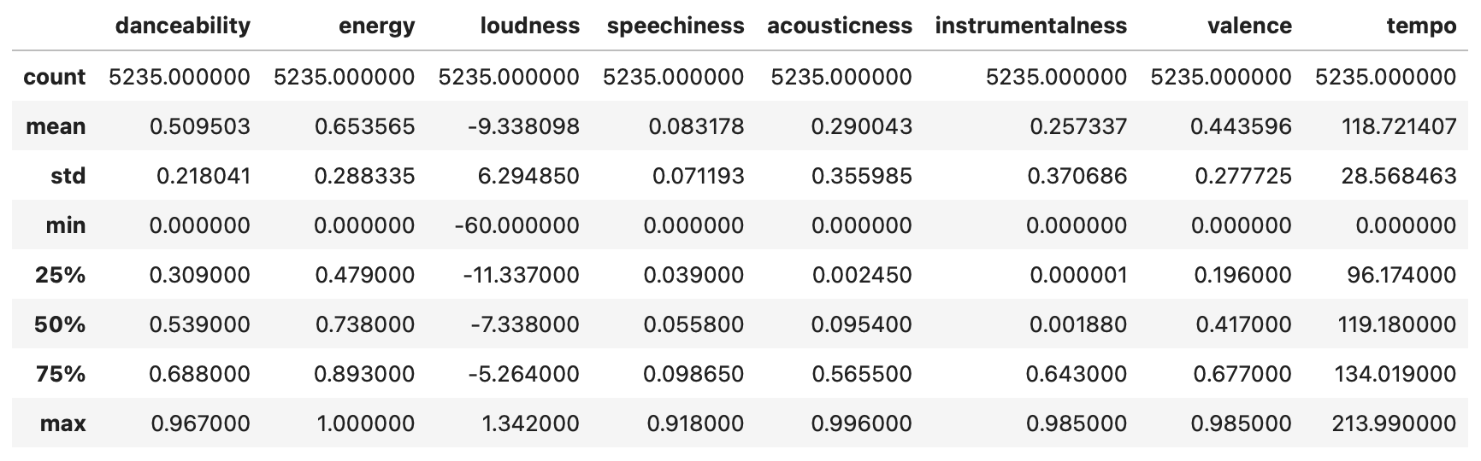
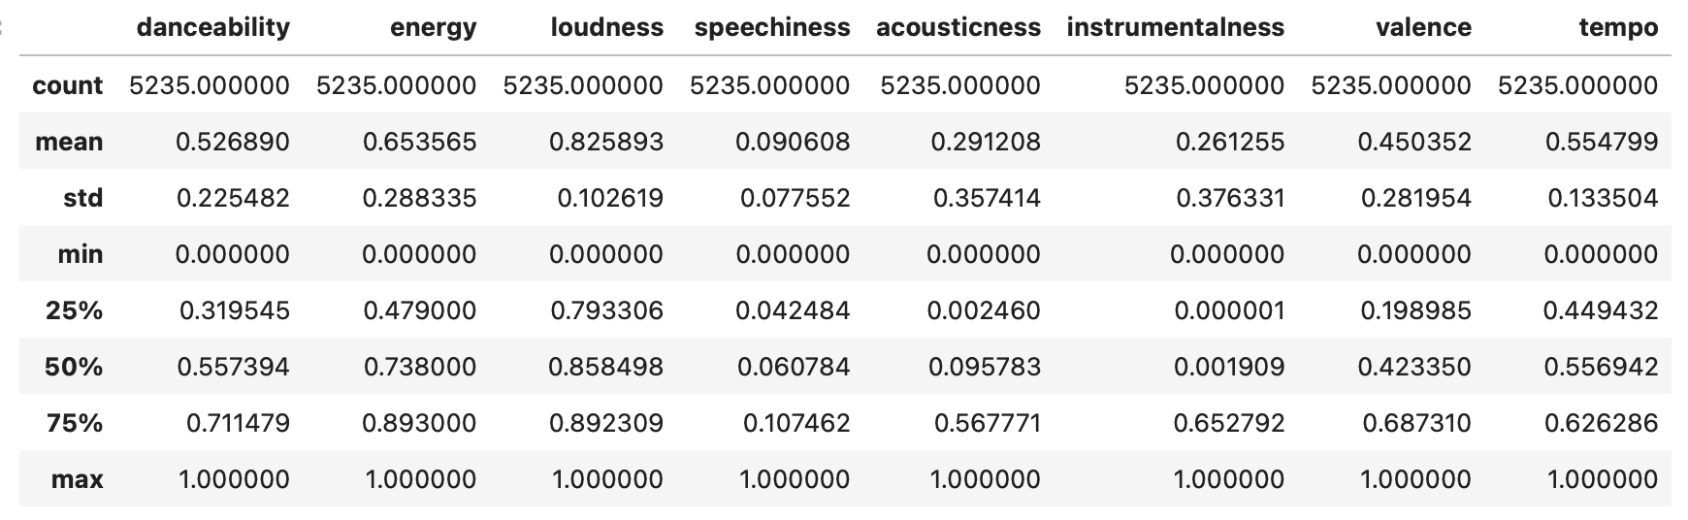
SCALING
Before scaling
After Min-Max scaling

Slide 5
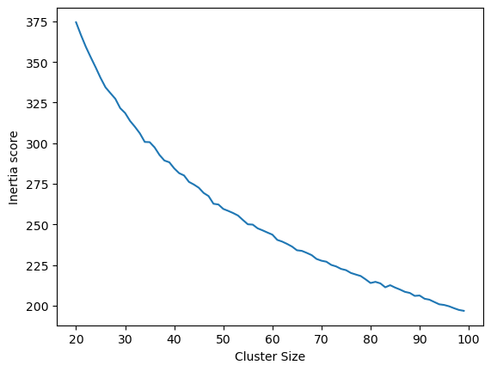
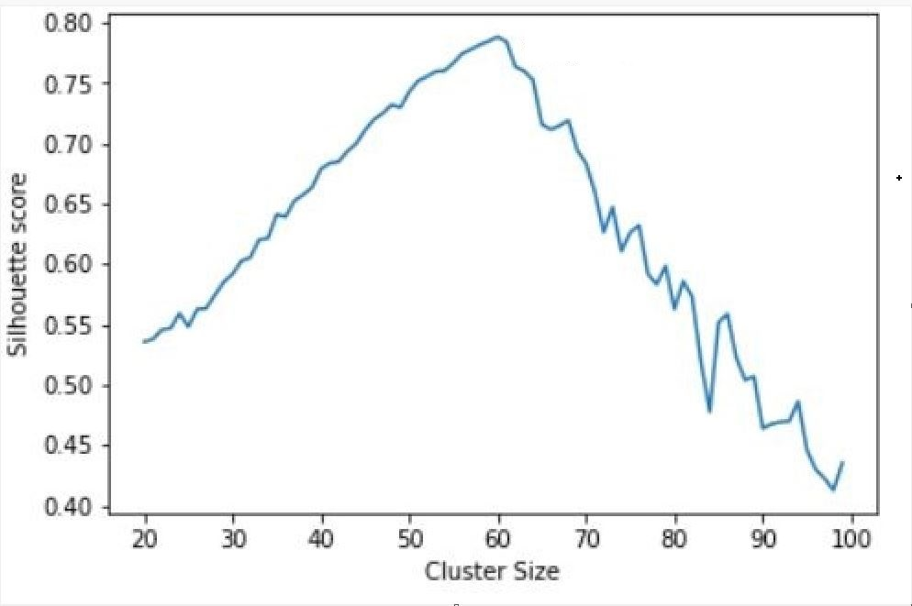
CLUSTERING SONGS USING K-MEANS

Slide 6
CLUSTER ANALYSIS
Out of 60 clusters, we randomly took 2 clusters (0, 3) for further analysis
We compared the two clusters with regard to their features
In order to decide if the clusters are coherent, we randomly listened to some of the songs from each cluster
To proof our intuitions, we have collected data on genres through web scraping

Slide 7
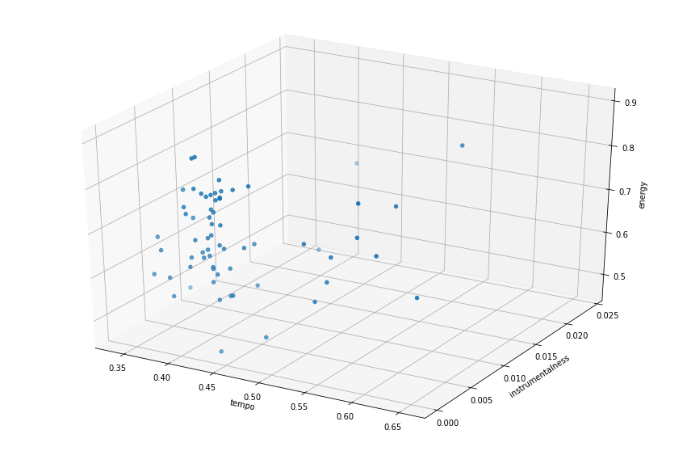
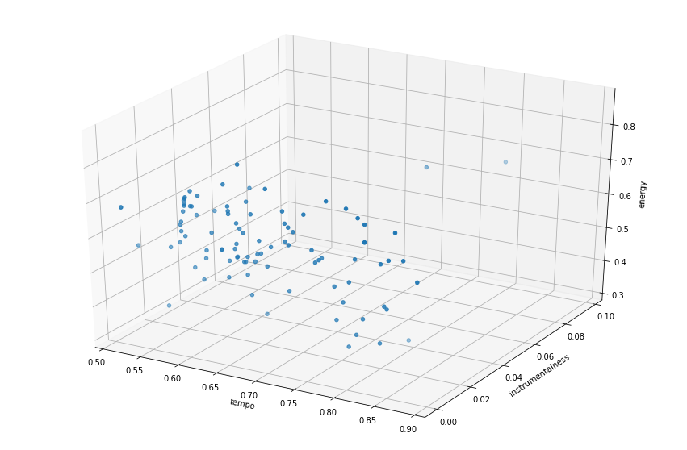
CLUSTER ANALYSIS
Features: Tempo, Instrumentalness, Energy
Cluster 0
Cluster 3

Slide 8
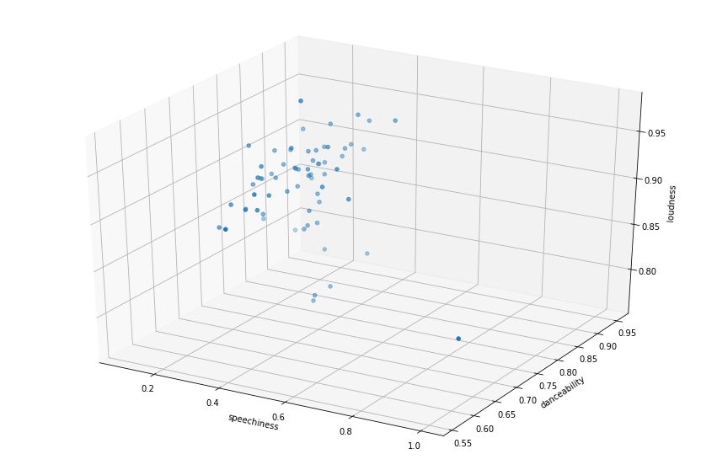
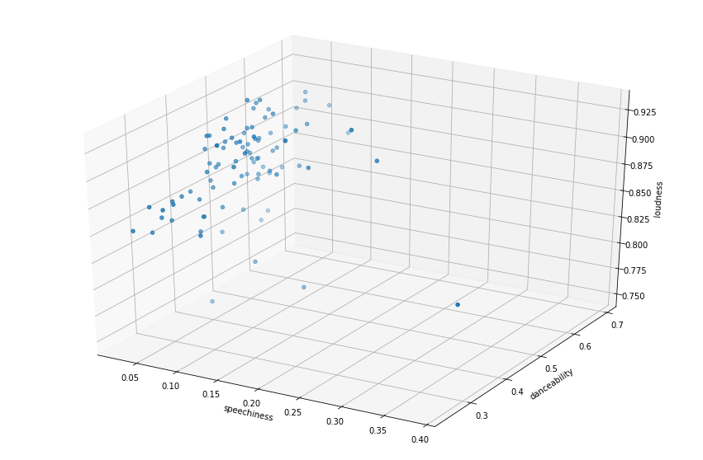
CLUSTER ANALYSIS
Features: Speechiness, Danceability, Loudness
Cluster 0
Cluster 3

Slide 9
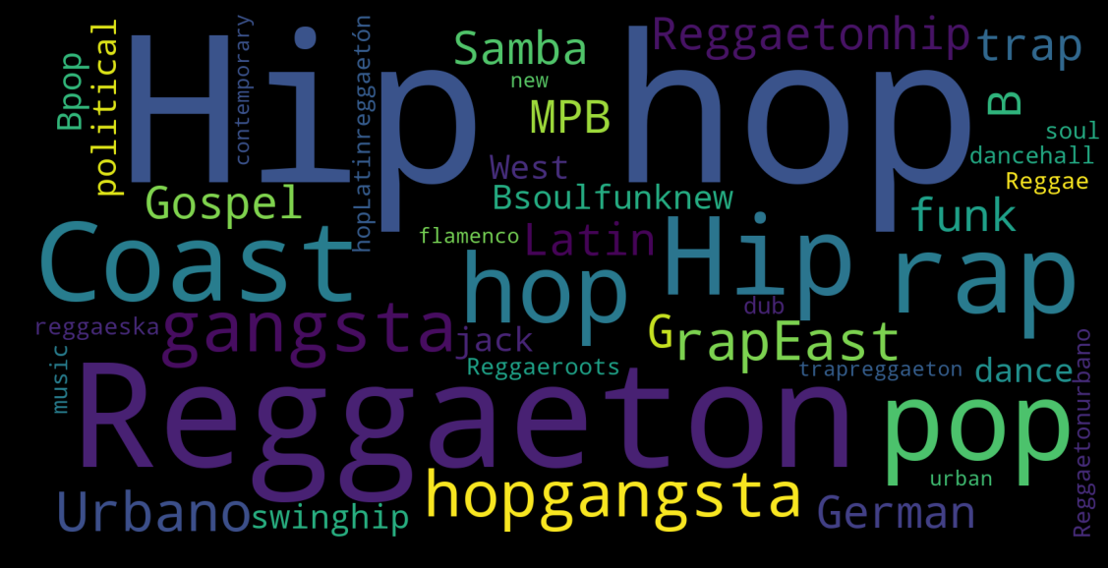
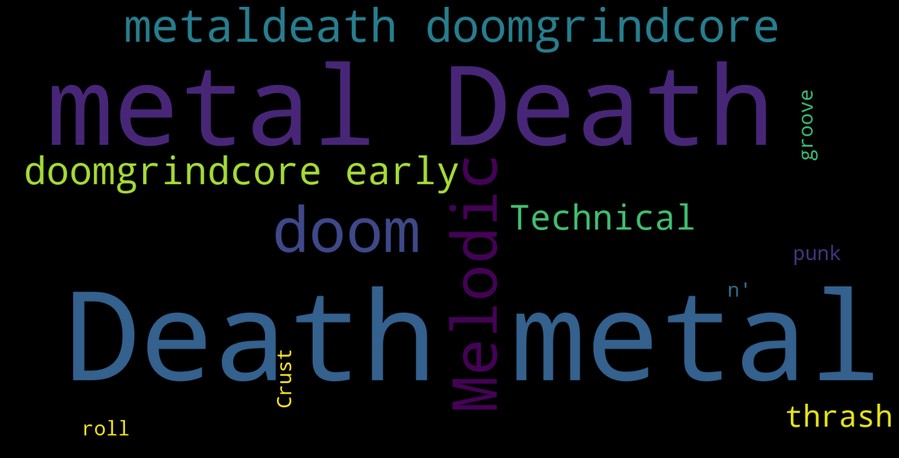
CLUSTER ANALYSIS
https://www.youtube.com/watch?v=FxQB1FYLu5k
https://www.youtube.com/watch?v=jo4i5mU8RV8
Cluster 0
“Sunday morning”
Cluster 3
“Messy day”

Slide 10
PROS AND CONS OF K-MEANS
Pros
Cons
Relatively simple to implement
Scales to large datasets
Guarantees convergence
Can warm-start to position of centroids
Easily adapts to new example
Generalizes to clusters of different shapes and sizes (e.g. elliptical clusters)
Choosing K manually
Being dependent on initial values
Clustering data of varying sizes and density
Clustering outliers (e.g. outliers may get their on cluster instead of being ignored)
Scaling with number of dimensions

Slide 11
CONCLUSION
Coming back to our research questions:
Are Spotify’s audio features able to identify “similar songs”, as defined by humanly detectable criteria? YES!
The songs in the clusters belong together
More features (e.g. popularity, genres) are recommended
Is K-Means a good method to create playlists?
Not easy to decide, since we have to explore other methods
Clustering is not accurate enough

Slide 12
Thank you for your attention!

